Slide 1
The Weekend Navigator
Session 5
Other Electronics

Slide 2
The Weekend Navigator
Radio Detection And Ranging

Slide 3
Radar
Electronic piloting
Penetrates fog and darkness to give a picture of surrounding objects
Elevates standard for “proper look-out”
Shows certain weather conditions
Effective Range depends on
Height of antenna: Higher is better
Beam width: Narrower is better
Power: More is (not always) better
Notes:
Radar isn’t electronic navigation, as is GPS, but rather electronic piloting.
Inland Navigation Rules that apply to radar use: Rule 5, Look-out, Rule 6, Safe Speed, Rule 7, Risk of Collision, Rule 19, Conduct of Vessels in Restricted Visibility.
Range in nm = 1.22 x √ height of antenna) Example: 12 ft high antenna will have a good range of 4.23 nm
On small craft, high power is not critical due to the height of the typical antenna installation, which inherently limits range. Additionally, smaller, highly maneuverable vessels, are usually more concerned with targets closer in.

Slide 4
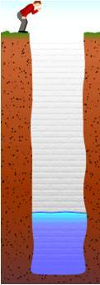
Echo
Shout into a well
Measure return time
Use speed of sound to calculate depth
Radar works the same way
Notes:
When you shout into a well (sound wave), the sound of your shout travels down the well and is reflected (echoes) off the surface of the water at the bottom of the well.
If you measure the time it takes for the echo to return and if you know the speed of sound, you can calculate the depth of the well fairly accurately.
RADAR works the same way. The length of time between the electronic pulse (radio wave) and the moment that the antenna receives the pulse back is determined by the distance between the antenna and the surface that creates the echo.
It then converts the time into a distance shown on your screen.

Slide 5
Radar Display
A radar pulse hits object and is reflected back toward the antenna
Metal is better than wood
Fiberglass is slightly better than wood
Flat is better than round
Echo – returning pulse
Targets – images resulting from echoes
Notes:
5
Chapter 24, Advanced Topics in Radar, addresses the more technical aspects of this topic.

Slide 6
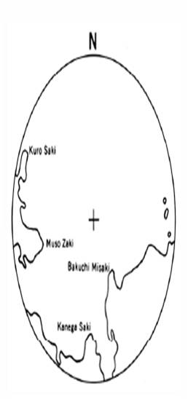
Radar Display
Caution! The image looks different than reality
GPS & Chart Radar
Notes:
6
Chapter 24, Advanced Topics in Radar, addresses the more technical aspects of this topic.

Slide 7
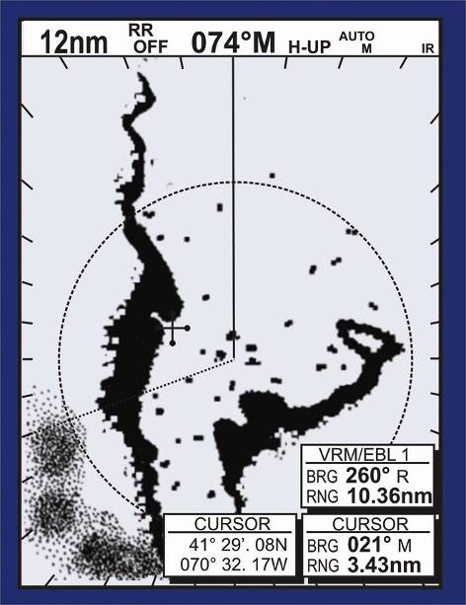
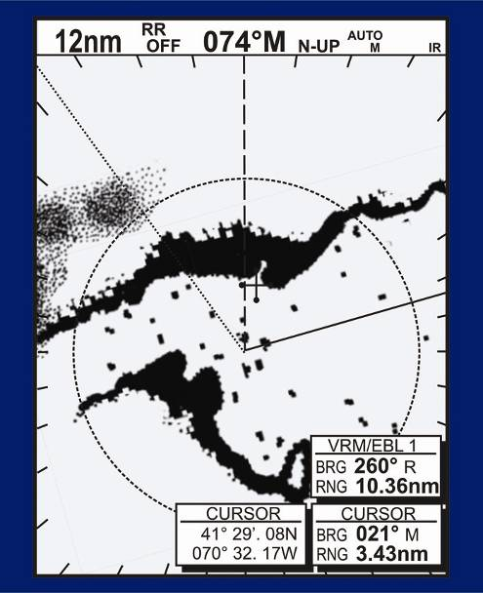
Orientation
Fig15-5
Heads-UP (track-up) Display
North-UP Display
Notes:
Left image oriented with boat Heads-up.
Right image oriented with North-up. Available only if GPS equipped.
Blip sizes do not necessarily reflect object size.
Explain Heading line & Cursor.
VRM, EBL and Scales are covered in the next slide.

Slide 8
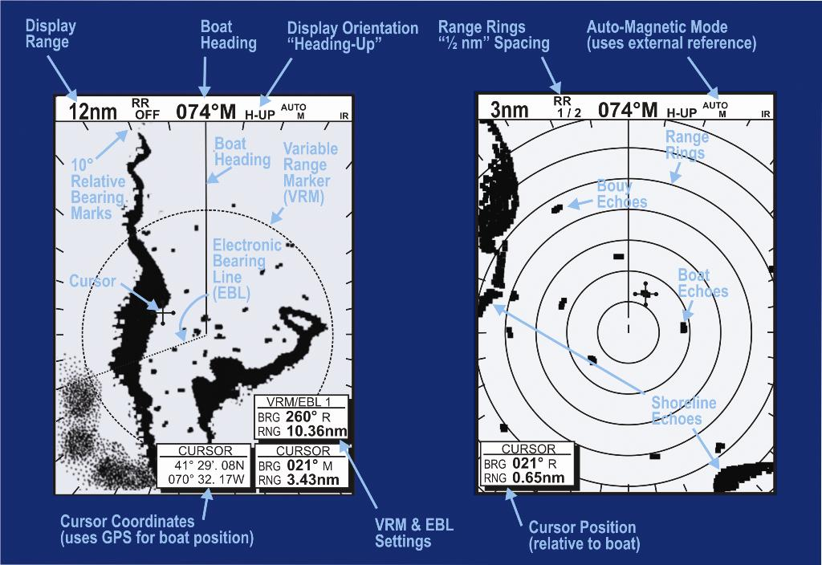
Range Rings- VRM- EBL
Fig.15-6 goes here
Fig15-6
Notes:
Range rings are adjustable
Some low-end Radar’s don’t have any heading references
VRM stands for Variable Range Marker. It is an electronic mark or ring that can be placed over any target on your radar display. An on-screen digital readout will let you know the precise range, in nautical miles, between the target and you
EBL – stands for Electronic Bearing Line. This marks the angle or clock position to the object from your movement.

Slide 9
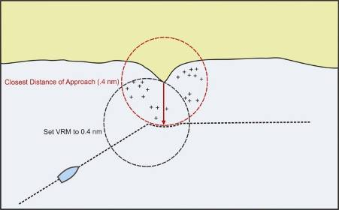
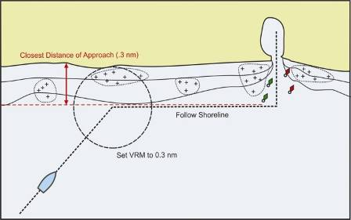
Avoiding Danger
Use radar to monitor hazardous areas
Set your VRM to a radius that avoids the hazard
Use VRM to find your way home
Figs 23-5 & 6
Notes:
Not all Radars have this VRM offset feature

Slide 10
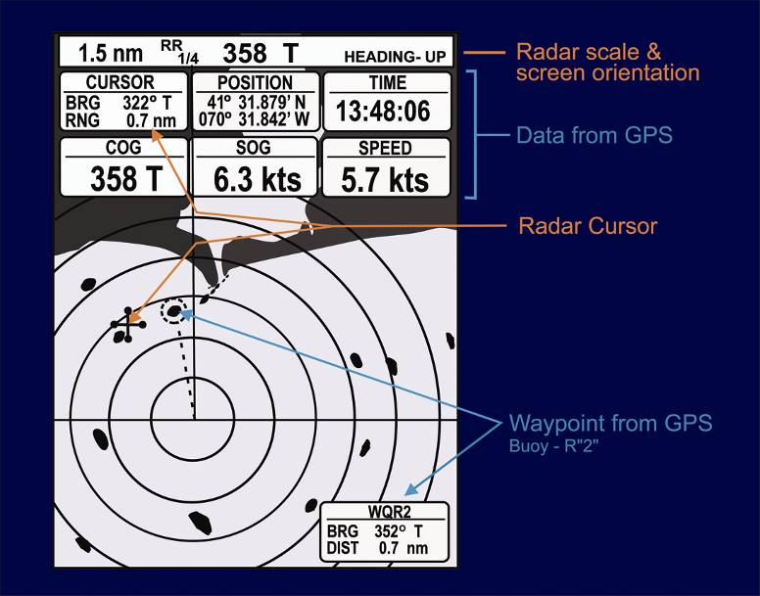
Integrating Radar-GPS
Notes:
GPS information is displayed on radar screen.

Slide 11
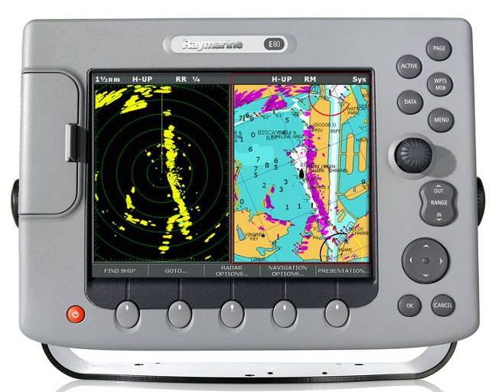
Overlaying GPS w/ Radar
Notes:
GPS map screen is overlaid with radar information.
Image from http://www.raymarine.com/SubmittedFiles/e-series/images/E80_radar_overlay_split_800w.jpg

Slide 12
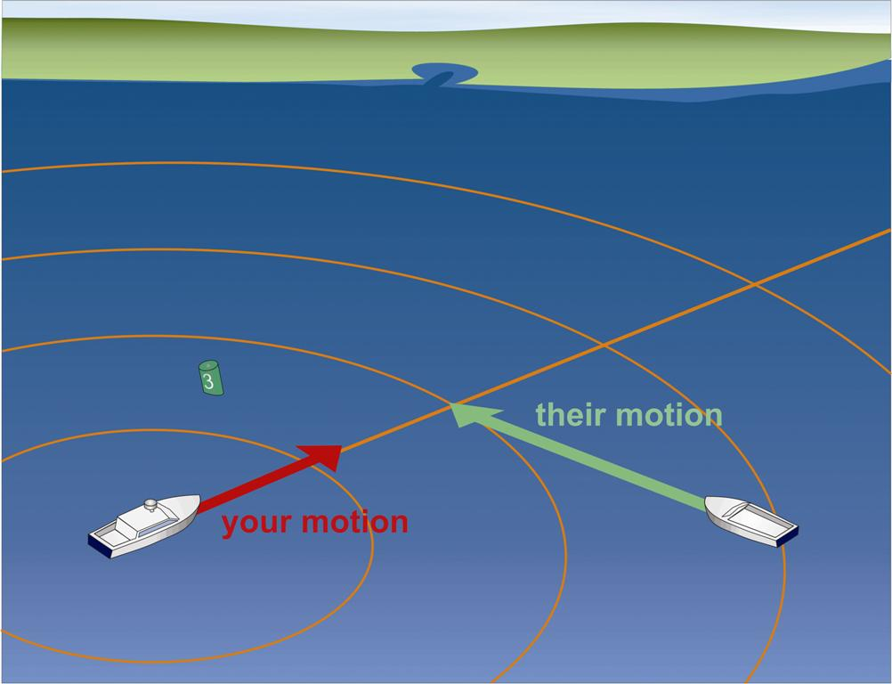
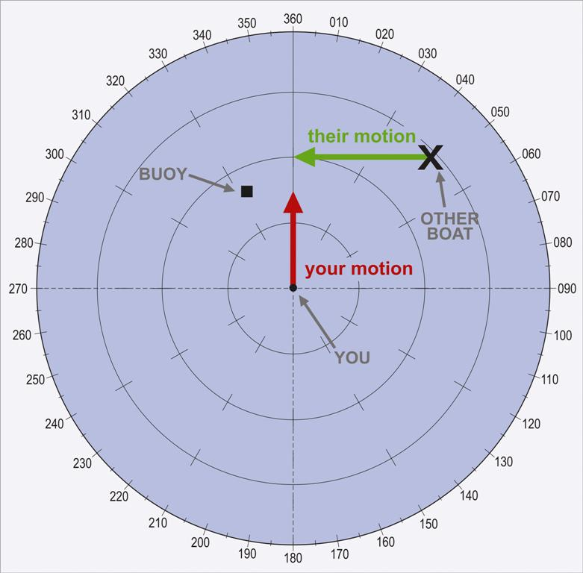
Relative Motion
Fig. 15-9
Notes:
This and the next two slides depict relative motion.
There is temporary confusion when boat turns.

Slide 13
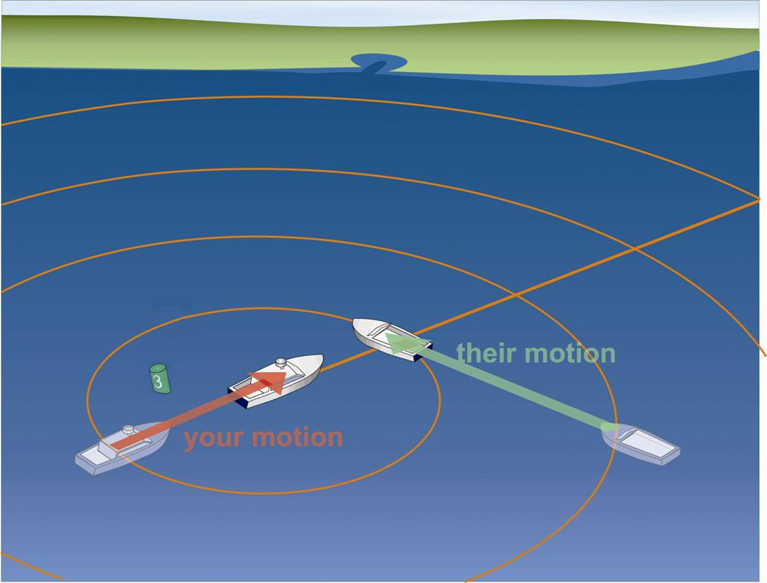
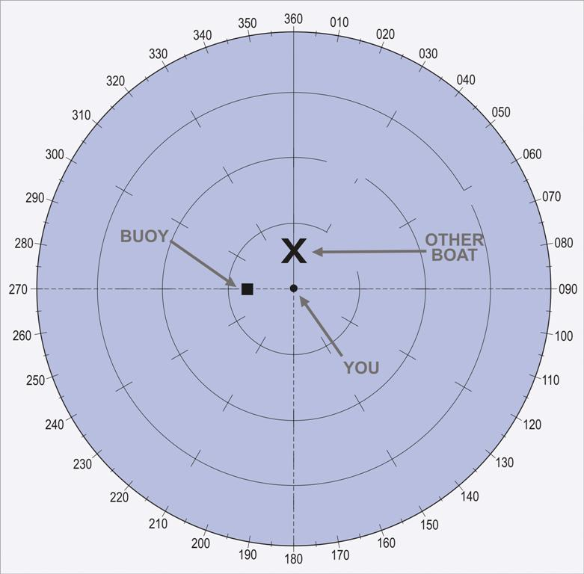
Relative Motion
Fig. 15-9
Notes:
This and the next two slides depict relative motion.
There is temporary confusion when boat turns.

Slide 14
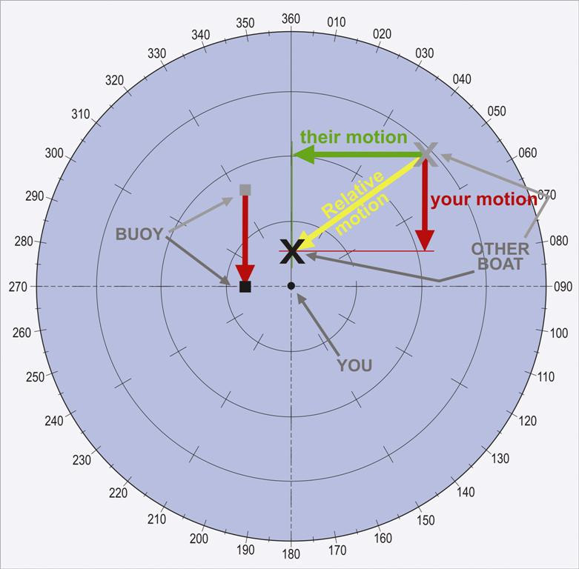
Relative Motion
Fig. 15-9
Notes:
This and the next two slides depict relative motion.
There is temporary confusion when boat turns.

Slide 15
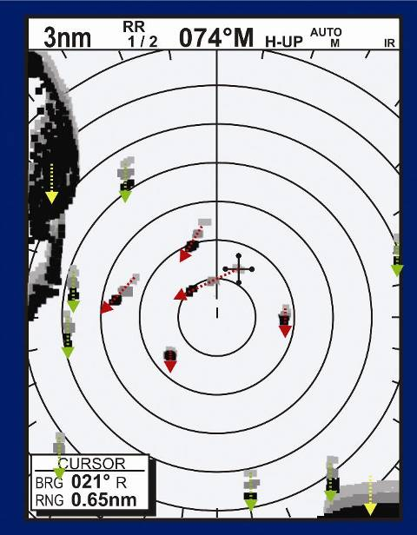
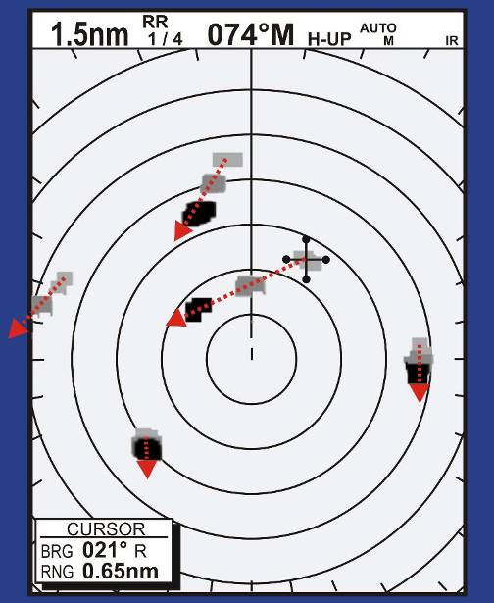
Assessing Speed of Targets
Fig. 15-10
Notes:
Explain how to detect objects that are stationary versus moving in different directions

Slide 16
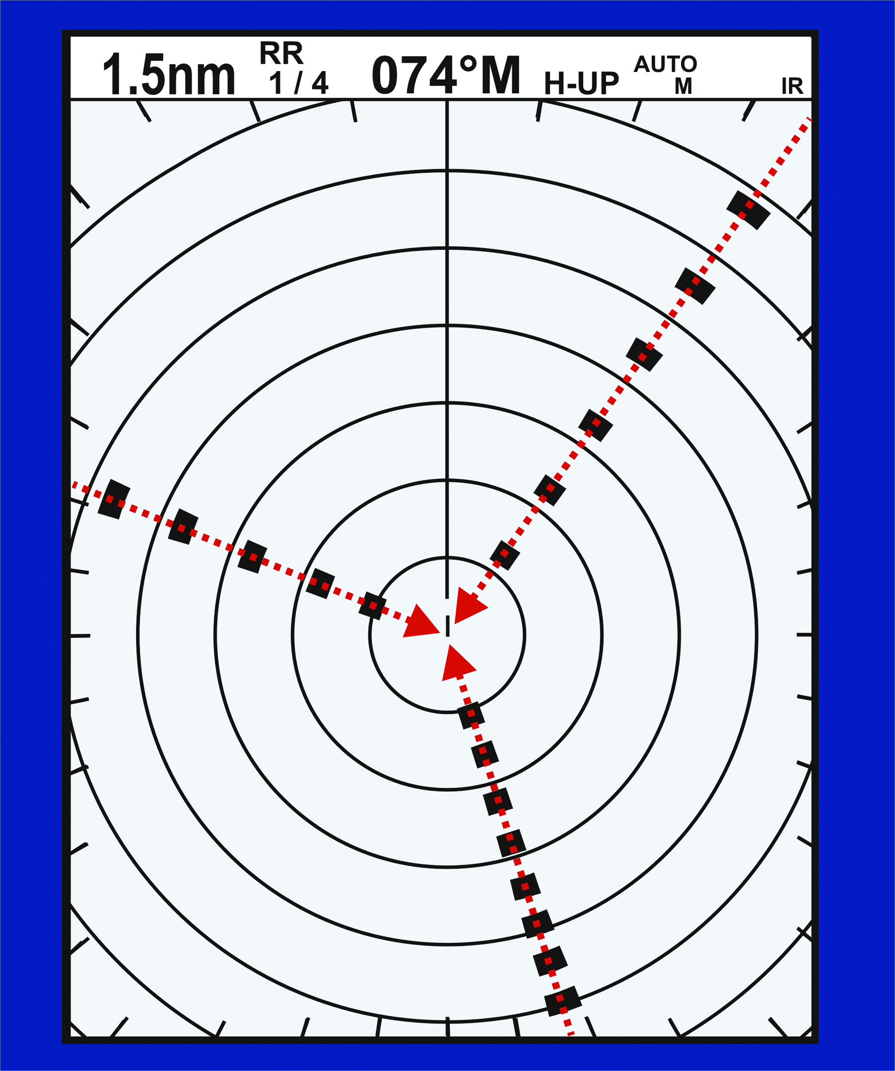
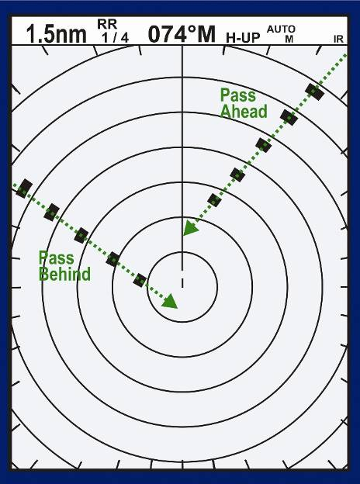
Collision Avoidance
Collision
No collision
Fig 15-11
Fig 15-12
Notes:
Fig. 15-11. Constant bearing, decreasing range. A collision will occur unless somebody does something. The next two slides illustrate what can be done.
Fig. 15-12. Any boat whose relative bearing is changing will skirt the center of the display (and miss your boat) unless one of you alters course.

Slide 17
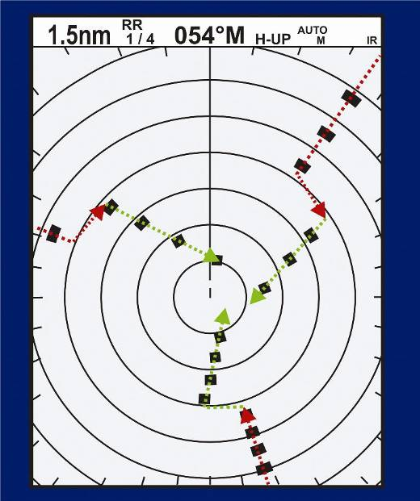
You Change Direction (20° to Port)
Fig 15-11
Fig15-13
Notes:
The collision scenario image is here to compare what the maneuver accomplishes to what happens if no maneuver is made.
Fig. 15-13. In this Fig., a turn was made to port. A quick check shows that, apparently, the risk of collision no longer exists. However, any turn will temporarily confuse the display. Wait a few sweeps to determine whether any of the boats still presents a risk of collision.
A starboard turn is preferred under the Navigation Rules.

Slide 18
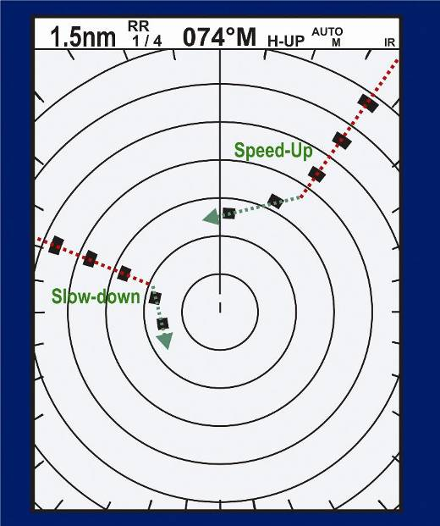
They Change Speed
This one
This one
Fig15-14
Notes:
Explain what happens when speed changes are made, again in relation to the collision scenario.

Slide 19
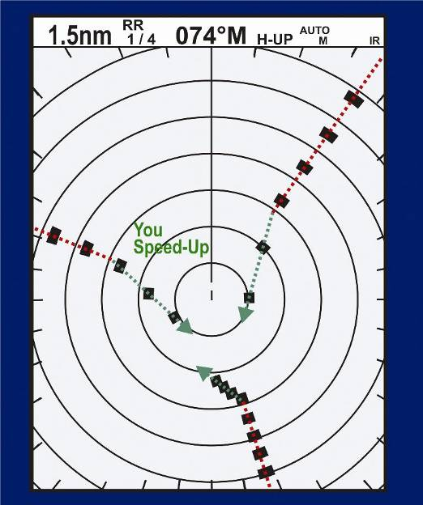
You Change Speed
Fig15-14
Notes:
Explain what happens when speed changes are made, again in relation to the collision scenario.

Slide 20
“Seeing” Weather
Adjust to reduce rain clutter
Rain generally returns as a speckled pattern of random dots
Helps you spot severe squalls
Get a range to the storm
Squall appears as a band of dense echoes moving forward at a steady rate
In restricted visibility
Slow down
Sound proper signals
Notes:
Shown as large solid slow moving masses or random dots.

Slide 21
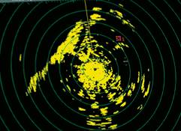
“Seeing” Weather
Weather Clutter – Rain Front
Weather Clutter – Scattered Showers
Wave Clutter – Local Wave Tops
Contacts or ATONS
Notes:
This control is sometimes known as FTC or differentiation and, as its name suggests, is used to remove the clutter caused by meteorological effects such as rain, snow or hail. A heavy rain shower can be quite an effective reflector of radar pulses, but it does not reflect them in the same way as a solid object. Instead of returning an echo which is a crisp copy of the transmitted pulse, rain echoes are weaker but more drawn out.
On the screen this produces a large but relatively diffuse contact, often described as looking like a smudge or 'cotton wool‘
Sea Wave Clutter is sometimes called STC or swept gain, and is used to remove the clutter caused by echoes from waves, that can otherwise form a bright circle or star-burst pattern in the center of the screen.
Under normal conditions - with the sea clutter control turned down - the radar may be receiving echoes from targets at a variety of different ranges, but with much weaker echoes from very distant targets than from targets close at hand.
The sea clutter control works by reducing the amplification of early returns even more, while leaving the later levels of amplification intact. On the screen this has the effect of obliterating weak contacts close to the boat, allowing stronger contacts to show up more clearly. If it is overdone, however, the sea clutter control is quite capable of suppressing the amplification to such an extent that even the strongest contacts - such as land - are obliterated at ranges up to several miles from the boat. It should be used with considerable caution and always as little as is necessary.

Slide 22
The Weekend Navigator
Radio Detection And Ranging
A Scenario For Discussion
A few more are located in the Additional Slides
Notes:
Refer to Instructor Guide Appendix E

Slide 23
Scenario 1
I’m underway with visibility about ½ mile. My GPS and Radar are on, and I’m on a GPS planned course steering with my compass.
After I was on my course for a while, I notice that my GPS is out. How do I find out where I am?

Slide 24
Scenario 1
Answer:
Determine the last location where you confirmed your location and time.
From that point, use dead reckoning to estimate your current position.
Identify nearby navigation aids on the chart that are in your general area.
Identify very distinctive nearby shoreline shapes.

Slide 25
Scenario 1 (cont)
Try to match some of these characteristics on your Radar screen. Ignore moving Radar targets because they are boats.
Take an Electronic Bearing Line (EBL) to the targets you identified and plot them on your chart.
Measure and plot the distances from these targets using your Variable Range Marker (VRM).

Slide 26
Scenario 1 (cont)
If you get a match with one or more of these target areas with your estimated dead reckoning position, you have confirmed your location.
Compare charted depths with your depth finder to further confirm your position.
Notes:
Time permitting, this may be a good place to stop and review the Radar scenarios in Instructor Guide, Appendix E. Slides for the remaining three scenarios are in the Additional Slides section.

Slide 27
The Weekend Navigator
Electronic Compasses

Slide 28
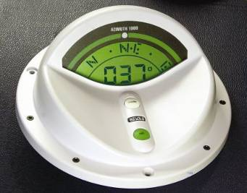
Fluxgate Compass
Requires an electric source
Senses the earth’s magnetic field on two small electric coils
Immune from ships magnetic fields
Output can be read by electronic equipment
Notes:
Can be calibrated to offset the local magnet fields ((Deviation) by driving slowly in a circle.
Can be adjusted for damping.
No mechanical parts
Reminder—a traditional compass is essential for a backup

Slide 29
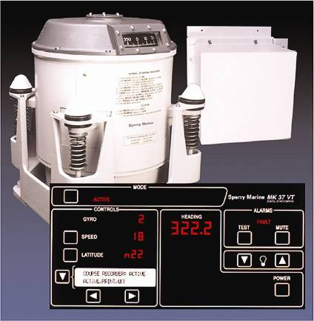
Gyrocompass
Internal gyroscope- doesn’t want to turn
Highly accurate
Very expensive
Used on large ships & aircraft

Slide 30
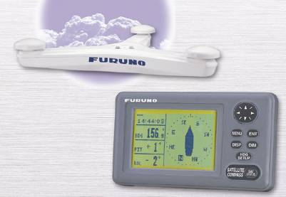
GPS Compass
Usual GPS compass works only when moving, has a delay- crude compass
GPS compass uses two GPS sensors separated by 30”, and analyzes the signals differences
Highly accurate- competes with the gyrocompass

Slide 31
The Weekend Navigator
Autopilots

Slide 32
Autopilot
Automatically steers a boat using any electronic compass as a reference
Keeps boat on selected course
Steered with GPS- compensates for drift
Steered with wind sensor- allows sailboats to automatically sail properly to the wind
Must keep a “proper look-out”

Slide 33
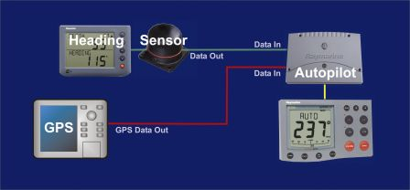
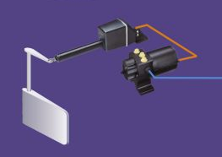
Autopilot
Fig19-4
Notes:
Requires a separate heading sensor because GPS heading data has a time delay and requires movement. That’s not a problem for manual steering, but its too slow for electronic steering.
All equipment interconnections must meet same standard ( most common NMEA 2000)
A autopilots can work independently-without GPS.

Slide 34
The Weekend Navigator
Using Depth to Navigate

Slide 35
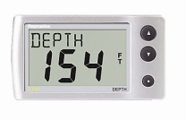
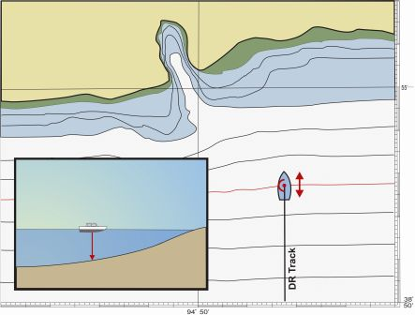
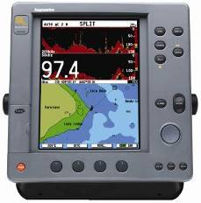
Navigating with a Depth Sounder
Using depth with a GPS and charts
Quick way to cross check your location
Correlate measured depth with charted depth
Fig16-9
Notes:
35
Depth readings can be superimposed on a GPS or Radar
Uses timing of pulses to determine depth (like radar)
Two frequencies available –explain
When an estimate is made on the current location, the observed meter depth can be compared with the assumed chart depth. If the two depth are significantly different it can be concluded that the estimated position is wrong.

Slide 36
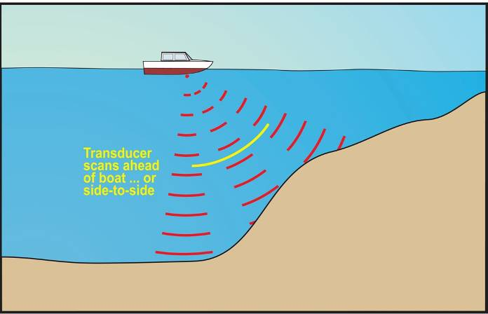
Sonar Depth Sounders
Sonar feature can:
Scan the bottom to look ahead
Show bottom contour
Fig16-5B

Slide 37
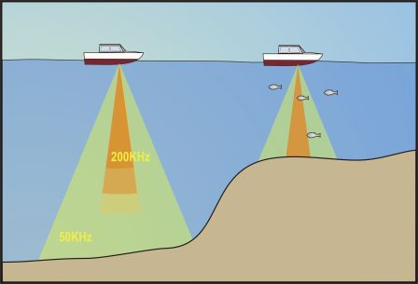
Depth Sounders vs. Fishfinders
“Fishfinders”– variant of the depth sounder
Translates blips above bottom into fish icons
Returns all echoes on screen in graphic form
Fig16-6
Notes:
37
50 kHz beams are around 46 deg normal or 20 deg in high end units
200 kHz beams are around 12 deg normal or 8 deg in high end units
Example: A 40 deg beam in 50 feet of water would produce a signal cone of 36 ft in diameter on the bottom.

Slide 38
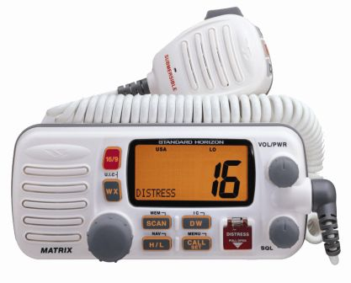
The Weekend Navigator
VHF Marine Radios

Slide 39
Communication Systems
CB Radios
Walki-Talkies, etc.
Cellular Telephones
Not monitored by other boats
Cannot be located by DF
Coast Guard local number: ???-???-????
VHF fixed-mount verses handheld
Notes:
Enter the local CG number on the slide or provide it to the students.
CB Radios are 26.96 MHz to 27.40 MHz
Walki-Talkies are 27 MHz and 400-5– MHz
Cellular Telephone are 800 – 900 MHz
VHF Marine Band is 146.05 MHz to 162.025 MHz
Know other numbers to tell students also in the event of an emergency.

Slide 40
Purpose Of Marine Radios
Safety
Distress, Urgency & Safety Messages
Operations
Call Lock Master, Bridge Tender, Marinas, Other Boats
Commerce
Messages Between Commercial Vessels And Stations
Public Correspondence (Marine Operator)
Notes:
The marine operator purpose is obsolete, but duplex frequencies are still protected for this function. A public marine telephone service existed in the past, and later became private for a fee (Sea Smart). That too was discontinued. No national service now exists.

Slide 41
Channels- A Partial List
CH 9 - Alternate Calling Channel
CH 13 - Navigation (Bridge to Bridge)
CH 16 - Distress, Urgency, Safety, Calling
CH 17- State Control
CH 22A - Coast Guard Liaison
CH 67- Commercial/ Navigation, Bridge to Bridge Lower Mississippi River
CH 68, 69, 71, 72, 78 - Non-Commerce Working
CH 70 - DSC
WX-1 thru WX-7
Notes:
Discuss the use of channel 16 (and 9 if used locally).
Provide a handout with all the numbers shown. They can be obtained from:
http://www.navcen.uscg.gov/marcomms/vhf.htm
Provide your local WX channel.
USA, Canadian and International frequencies/channels are sometimes different. Make sure the radio is set to correct band.

Slide 42
DSC
Digital Selective Calling (DSC)
Part of Global Marine Distress and Safety System (GMDSS)
Marine Mobile Service Identifier (MMSI)
How it works
Accidental activation?
Notes:
Address MMSI and how to get one.
Within the GMDSS, about 95% of the distress calls are false.
What to do if an accidental DSC or EPIRB call is made? Call the CG and state that your call is false. (Maybe put it in the form of a question to get student participation)
Boat US is www.boatus.com/mmsi/instruct.htm for the MMSI
GMDSS is Global Maritime Distress Safety System
EPIRB is Emergency Position Indicating Radio Beacon

Slide 43
Calling
Listen- confirm channel is clear
“Name of the boat you are calling”
“This is (name of your boat)”
“Over”

Slide 44
Calling Time Limits
1st Call - 30 seconds maximum
Then - wait 2 minutes
2nd Call - 30 seconds maximum
Then - wait 2 minutes
3rd Call - 30 seconds maximum
Then - wait 15 minutes before Additional calls to the same station

Slide 45
Mayday Call
Use when risk to life exists
Call on Channel 16
Call format:
“Mayday, Mayday, Mayday”
“This Is (Name Of Your Boat)”
State Location, Nature Of Problem, Number Of POB, Describe Boat And Condition
“This Is (Name Of Your Boat), Over”
Notes:
Explain why all the information is transmitted without a break for a reply.

Slide 46
Urgency, Safety & MARB
Urgency - Pan – Pan (Pahn -Pahn)
Safety of a vessel or person is in jeopardy (e.g., looking for overdue vessel, approaching storm)
Safety - Security (Say-cur-i-tay)
Navigation hazards (e.g., floating log)
Marine Assistance Request Broadcast
CG invites nearby boaters to assist a vessel with a non-distress problem
Notes:
Any boater can send Urgency and Safety messages, although they are most frequently sent by the Coast Guard.
Only the CG sends a MARB. Transmission example:
USCG on Channel 16 (156.8MHz)
HELLO ALL STATIONS. HELLO ALL STATIONS. HELLO ALL STATIONS. THIS IS COAST GUARD SECTOR HAMPTON ROADS RELAYING A MARINE ASSISTANCE REQUEST BROADCAST FOR A DISABLED PLEASURE CRAFT IN THE VICINITY OF THE FOURTH ISLAND OF THE CHESAPEAKE BAY BRIDGE TUNNEL, LISTEN CHANNEL 22A, OUT.
USCG on Channel 22A (157.1MHz)
HELLO ALL STATIONS. HELLO ALL STATIONS. HELLO ALL STATIONS. THIS IS COAST GUARD SECTOR HAMPTON ROADS RELAYING A MARINE ASSISTANCE REQUEST BROADCAST FOR PLEASURE CRAFT MOONSHINE WYT5138. PLEASURE CRAFT MOONSHINE IS A SEVENTEEN-FOOT FIBERGLASS OUTBOARD DISABLED DUE TO LACK OF FUEL IN VICINITY OF THE FOURTH ISLAND OF THE CHESAPEAKE BAY BRIDGE TUNNEL LATITUDE 37-03N LONGITUDE 76-04W. ANY VESSEL DESIRING TO ASSIST THE MOONSHINE IS INVITED TO PROCEED TO THAT LOCATION OR CONTACT HIM BY RADIO. PLEASURE CRAFT MOONSHINE IS STANDING BY CHANNEL (an appropriate intership frequency). IF YOU ARE OFFERING TO ASSIST THE MOONSHINE, PLEASE RESPOND AND PROVIDE AN ESTIMATED TIME OF ARRIVAL. OUT.

Slide 47
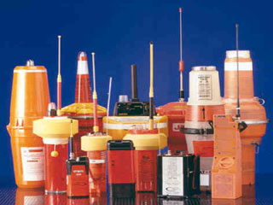
EPIRB
Sends your location when activated
Registration info identifies who you are
Manually or automatically activated
Can be rented for short periods
PLB
Notes:
Emergency Position Indicating Radio Beacon
Personal Locator Beacon

Slide 48
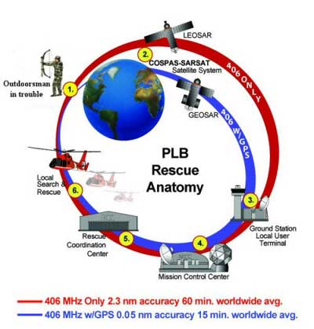
EPIRB/PLB
Boater in trouble
Notes:
Emergency Position Indicating Radio Beacon
Personal Locator Beacon

Slide 49
The Weekend Navigator
Integrating Your Electronics

Slide 50
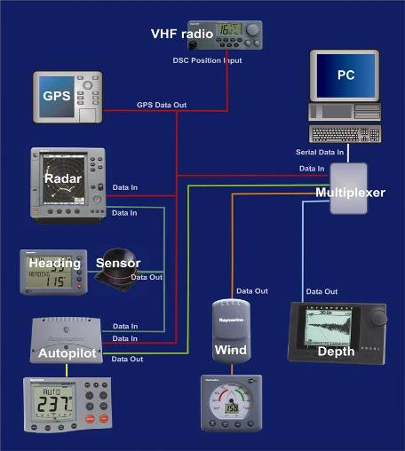
Instrument Integration
All electronic instruments integrated with computer
All integration with Radar
NMEA
Fig 26-2
Notes:
Need to check on how much integration can be done with Radar w/o a multiplexer
Explain multiplexer allowing total integration.
Not all components capable of integration.
NEMA is National Marine Electronics Association
Explain NMEA 0183 and NMEA 2000
A fast changing technology- like computers.

Slide 51
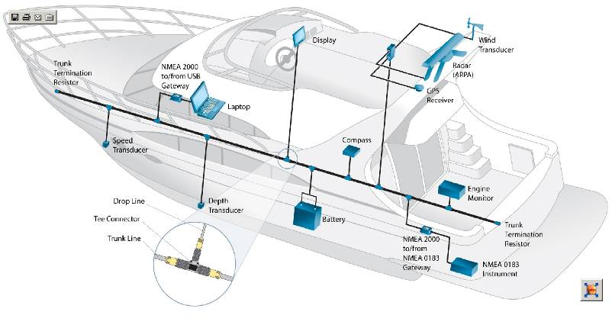
Instrument Integration
NMEA 2000
Notes:
NEMA 2000 is the new high level protocol based on the auto industry J1939 network
Uses multiple layer communications
Uses DeviceNet cables
NEMA 0183 is a serial bus and NEMA 2000 is a controller area network (Can).
Uses single layer communications
Uses normal shielded wire

Slide 52
A Final Few Words
All of this electronic equipment can make piloting safer and easier
BUT . . .
Plan the voyage
Navigate underway
Keep track & double check
Be Careful with the numbers!
Notes:
Reverting to the beginning of the course, the point was made that equipment fails, and often at the wrong time.
Double checking your piloting with standard piloting navigation techniques is prudent.
Have I been on this leg of the course about the right time?
Is there a landmark I can see that confirms my position?
Am I being careful?

Slide 53
The Weekend Navigator
Additional Slides

Slide 54
The Weekend Navigator
Radio Detection And Ranging
A few more scenarios for discussion
Notes:
Refer to Instructor Guide Appendix E

Slide 55
Scenario 2
I am returning home from a fishing trip. I hear static on my AM radio. I see distant dark clouds in my direction of travel. What can I do to predict if I should continue, or wait where I am, or retreat?

Slide 56
Scenario 2
Answer:
Listen to severe weather forecasts and storm tracking information on AM or FM radio and marine radio channel 16, and the local marine radio weather channel.
Using your radar, select a long range and track the movement of the storm.
Wait, or retreat, until the affects of the storm has passed your position.

Slide 57
Scenario 3
I am unexpectedly caught in a dense fog. I know I am near a busy shipping channel where large vessels are limited in their ability to maneuver. I hear a prolong blast every two minutes. Earlier the blast sounded distant but now sounds closer. What can I do?

Slide 58
Scenario 3
Answer:
Try to hail the approaching vessel on marine radio channel 16. Ask if the vessel has you on their radar and ask directions to keep a safe distance.
If you have working radar, set the range scale to 1/2 mile. Monitor the screen and keep a well clear.
Make sure your correct navigation lights are on and the proper horn signals are sounded.

Slide 59
Scenario 3 (cont)
Once you are on safe course away from the large vessel, set your radar range to 1/4 mile and proceed at a safe speed keeping a very sharp lookout by sight and sound.

Slide 60
Scenario 4
I am returning home and it’s dark and foggy. My navigation lights and my radar is set on 1/4 mile range. I’m approaching buoy #1 leading into my channel and according to my radar, a boat is overtaking me, another is heading towards me on my port side, and a third boat is approaching Buoy #1 from my starboard side. We are all on a collision bearing. What can I do?

Slide 61
Scenario 4
Answer:
Quickly issue a Security-Security-Security message on VHF Channel 16.
Warn all the vessels approaching buoy #1 you are slowing speed.
Sound the danger signal on your horn while slowly reducing speed.
Sound the danger signal again.
Keep a sharp lookout. Avoid a collision.
.

Slide 62
The Weekend Navigator
End Additional Slides

